Slide 1


Clôture comptable : Optimiser l’existant pour mieux automatiser demain
Notes:
Opening/Positioning:
"We empower accountants to automate themselves and own their future"
Emphasize lived experience: "I've done this, I've lived this, I've breathed this, and I now want to help you do this because I've sat in your shoes"
Differentiation: "We understand how to unpick the process and understand the reality, not just focus on technology and outcomes"

Slide 2
Introduction
Retour d’experience client
Hypercroissance et limites de l'existant
Pourquoi FloQast et le Close Management ?
La Vision
Optimiser aujourd'hui pour automatiser demain
Application Pratique du Close Management et des agents IA
Demonstration produit

Slide 3
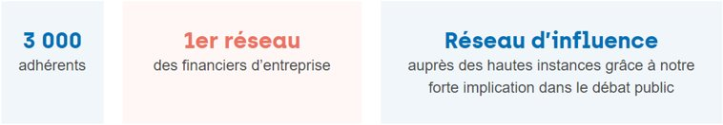
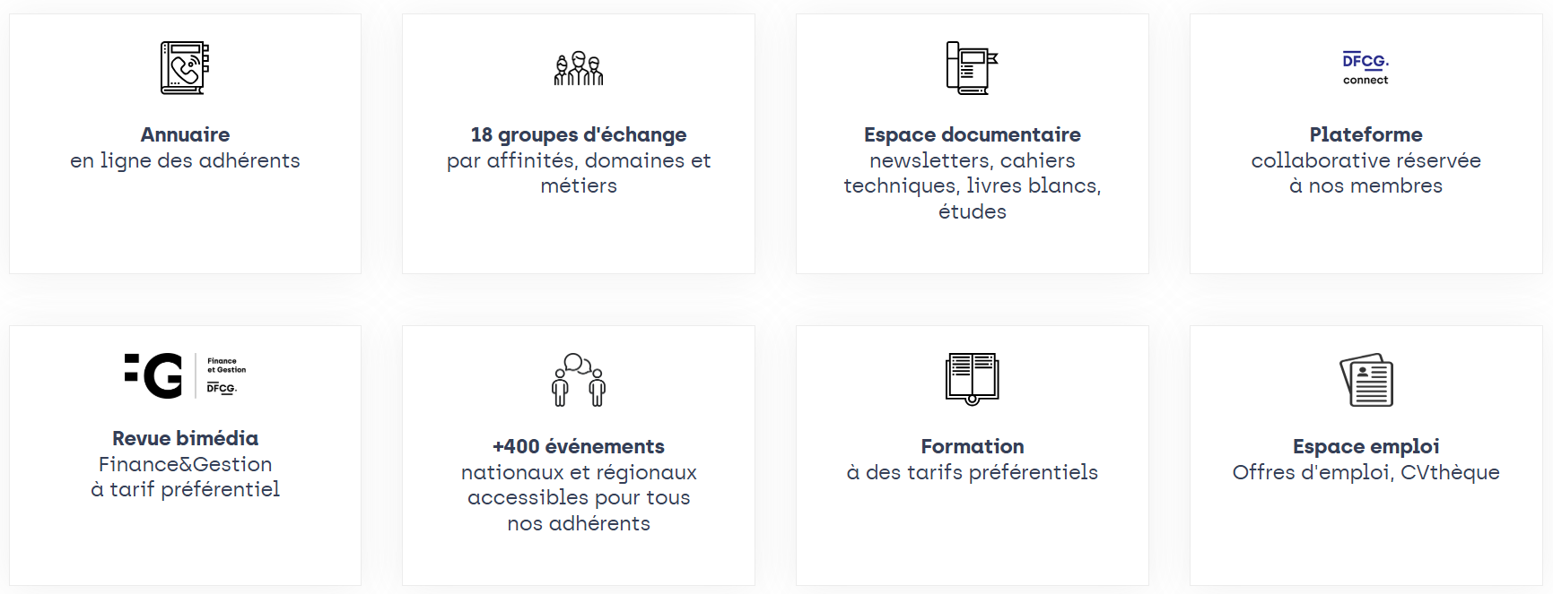
VOUS ÊTES FINANCIER D’ENTREPRISE ? ALORS REJOIGNEZ LA DFCG...
3 800
Un maillage territorial
17 régions

Slide 4
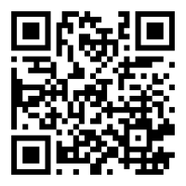
SCANNEZ LE QR CODE POUR PLUS D’INFORMATIONS
& POUR ADHÉRER À LA DFCG

Slide 5

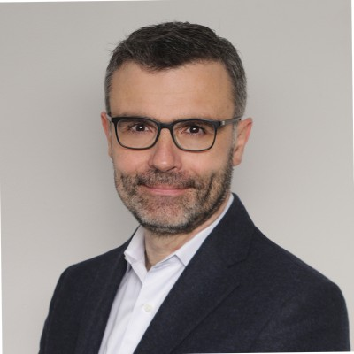
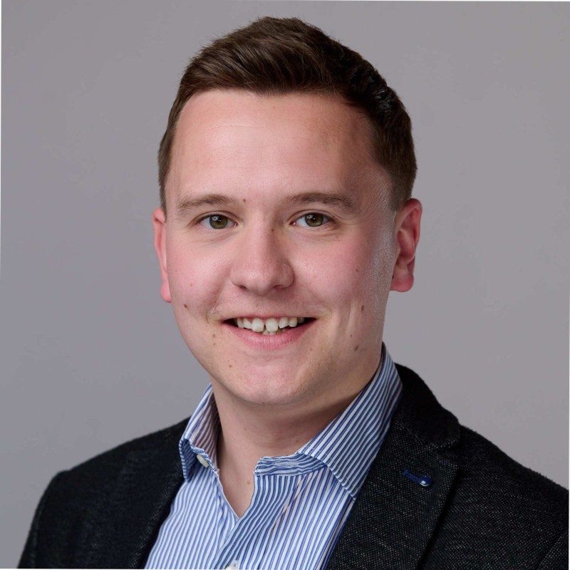


Intervenants
Benoît Rivière
Jean Yves-Martel
Matthew Whitley
Directeur des normes comptables et consolidation
Directeur Comptable
Directeur Commercial

Slide 6


















Créé par des comptables, pour des comptables
FloQast propose une plateforme d'automatisation comptable
Fondée en:
2013
par deux comptables
La comptabilité fait partie de notre ADN:
~80%
des collaborateurs en contact direct avec nos clients sont d'anciens comptables
+ de 3 500
clients
+de 850
grands comptes
Territoires:
Amérique, Europe, Asie-Pacifique
Présent dans plus de 170 pays (sur 6 continents)
+ de 55
nouveaux modules et fonctionnalités déployés chaque mois
+ de 35%
d’innovations produits par mois
Notes:
Who we are / Why we do it – For over a dozen years, we’ve supported customers in their close and compliance journeys – the biggest difference they’ve shared in comparison to other solutions? It’s clear FloQast was built by accountants, for accountants. It’s not just a tagline for us, it’s how we operate.
With global operations and a growing enterprise footprint, we’ll continue to innovate in FY26 investing ~35% of revenue into R&D, exceeding the average SaaS investment of 20-25%. In a world with countless AI vendors, most of whom were created by engineers or technologists, the combination of our accounting expertise, commitment to education and dedication to product is what sets us apart.

Slide 7

Workflows pilotés par l'IA
Optimisez
la clôture
VISIBILITÉ &
HARMONISATION
Automatisez
la clôture
AUTOMATISATION DES PROCESSUS
Agents IA
Prêts à l'emploi
Orchestration multi-agents
Personnalisés
Conformité Connectée
MAÎTRISE DES RISQUES
Workflows pilotés par l'IA
Notes:
WHY
Accounting work rarely comes in one big task. And that’s exactly where AI Agents can make the biggest impact.
HOW
Our agents operate across the entire FloQast platform — close, reconciliations, and compliance.
They leverage existing documentation, checklists, and institutional knowledge rather than forcing teams to start from scratch.
WHAT
One example: a large global investment firm doing fund accounting.
Their management fee allocation process used to take days.
Today:
an agent kicks off the task
standardizes the data
performs the calculations
creates and posts the journal entry
and validates that the related internal controls operated effectively
That’s the power of a customized AI Agent working across a unified platform.

Slide 8
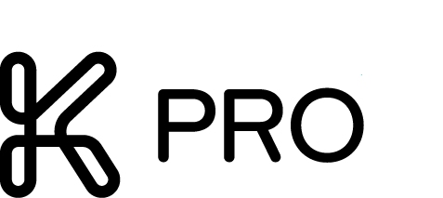
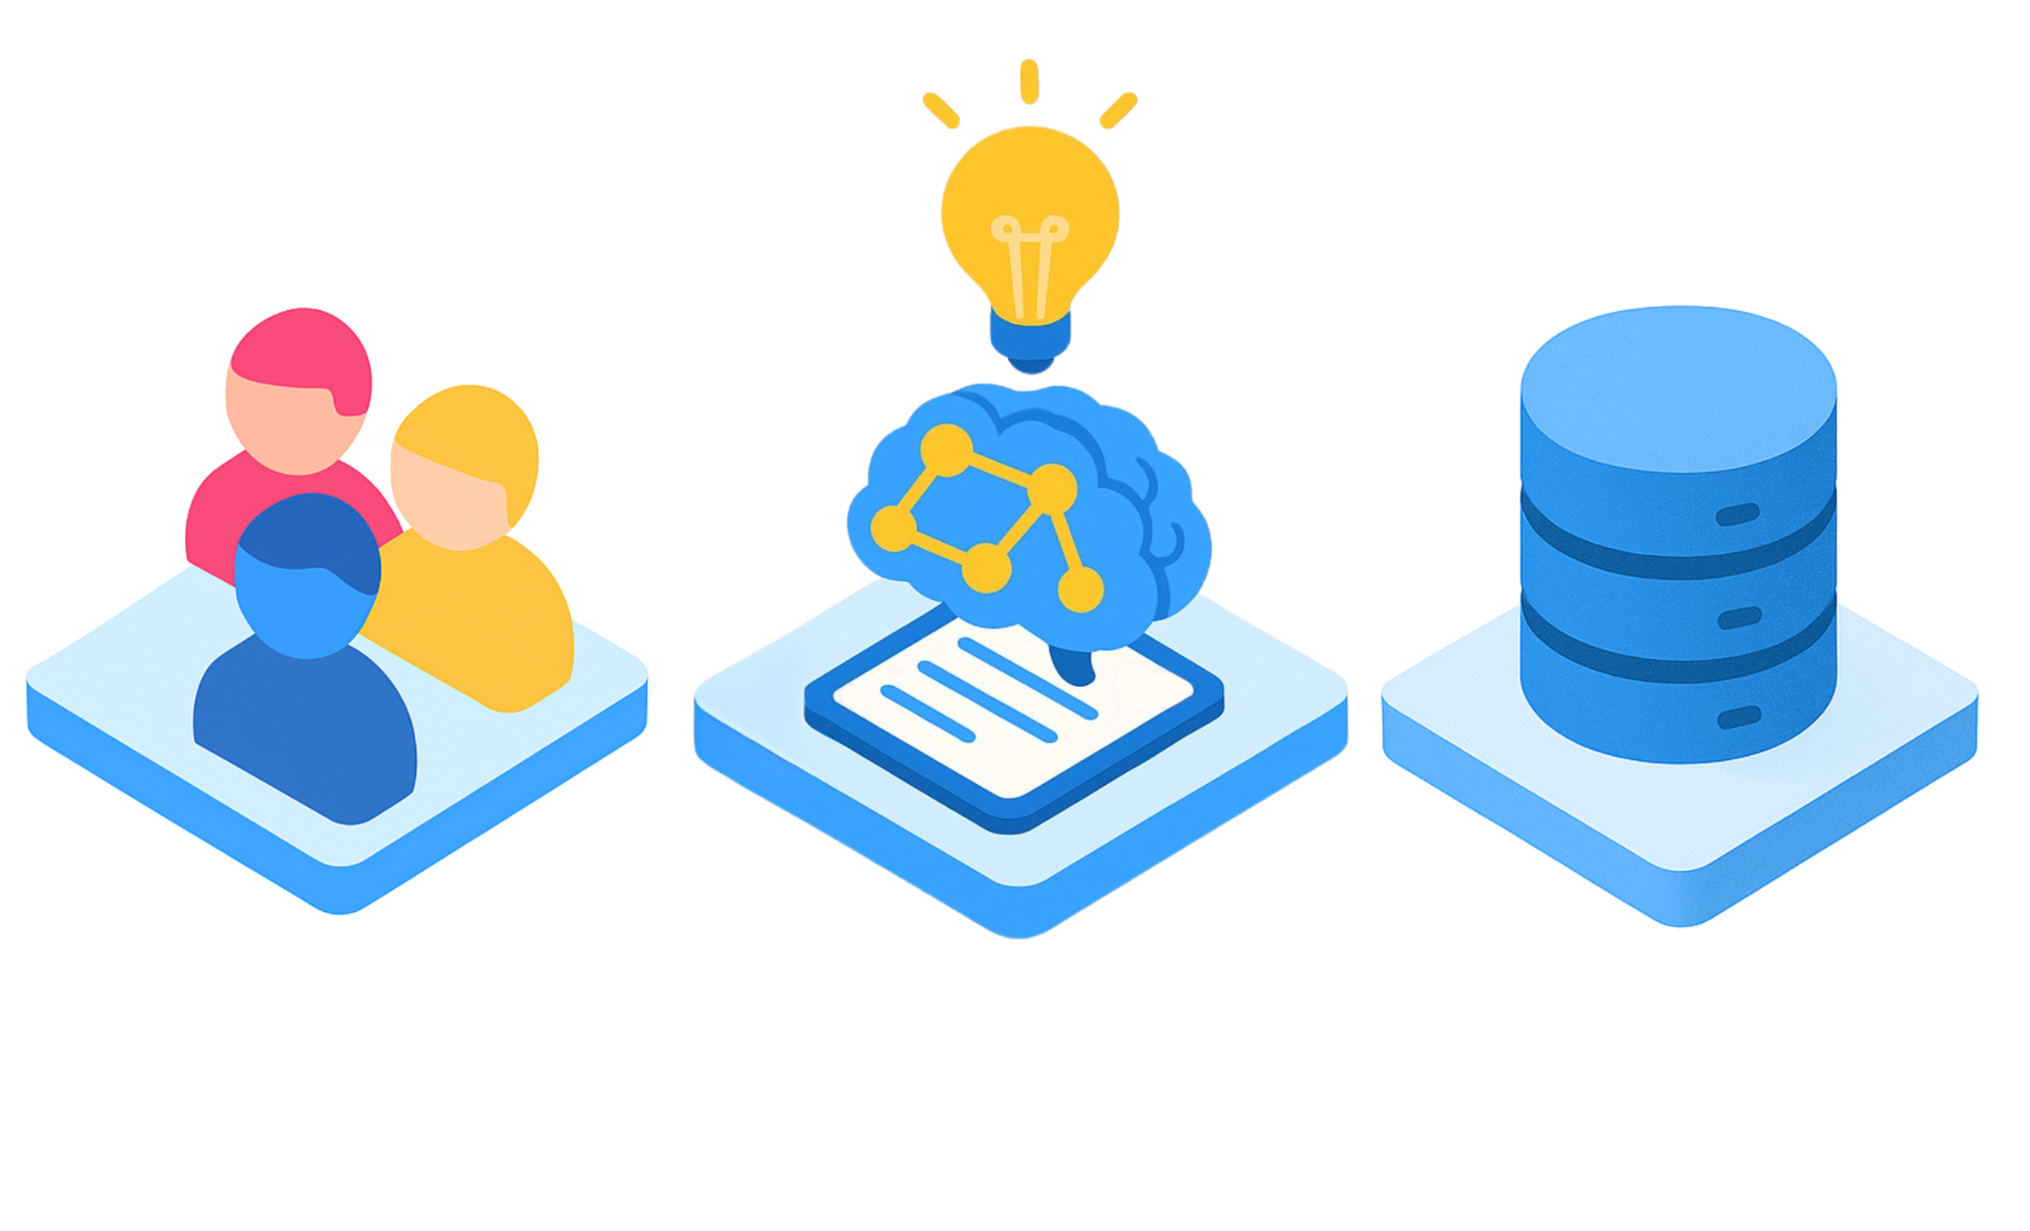

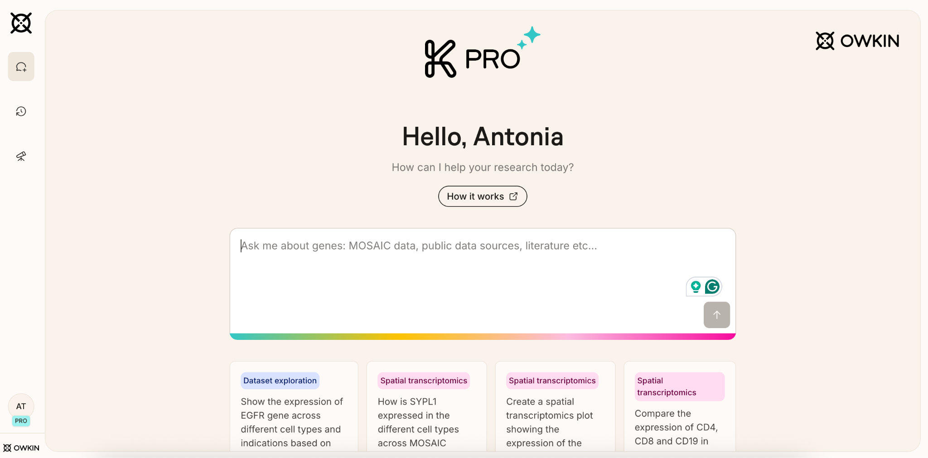
Owkin: The Agentic AI Powerhouse for Biology
200+
with top data scientists, biostatisticians, biologists, MDs
104
global academic institutions to access thousands of datasets
89
publications in leading
journals like Nature
1 AI Scientist. 100s of AI-certified skills. 100s of AI models for biology. 1.2M patients’ data.
Team
Data
Science

Slide 9
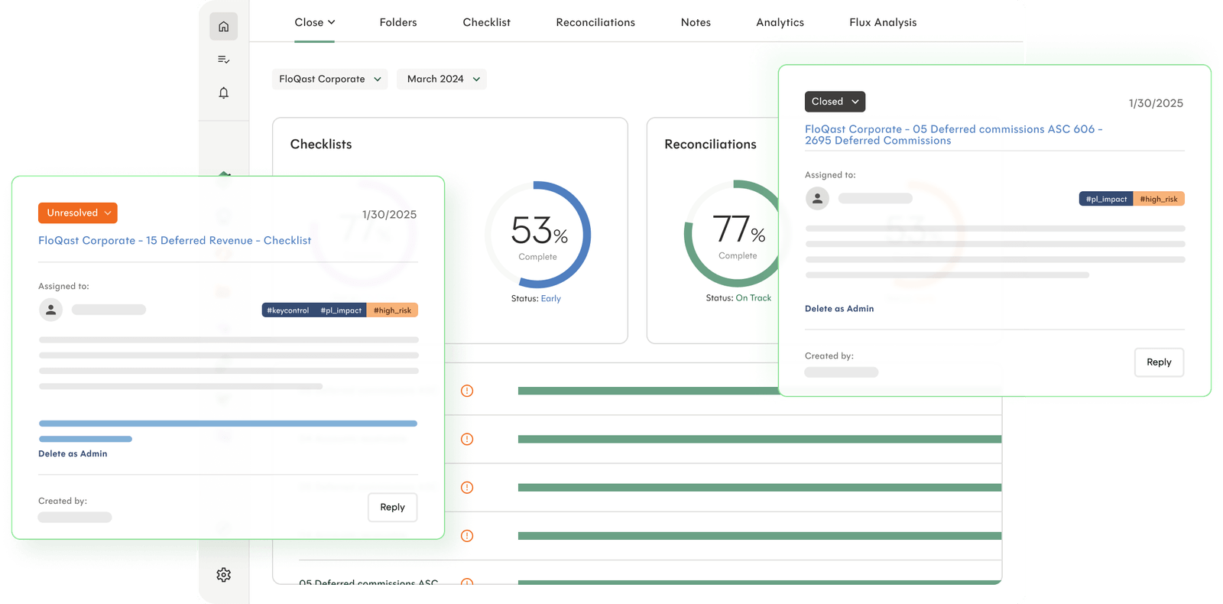
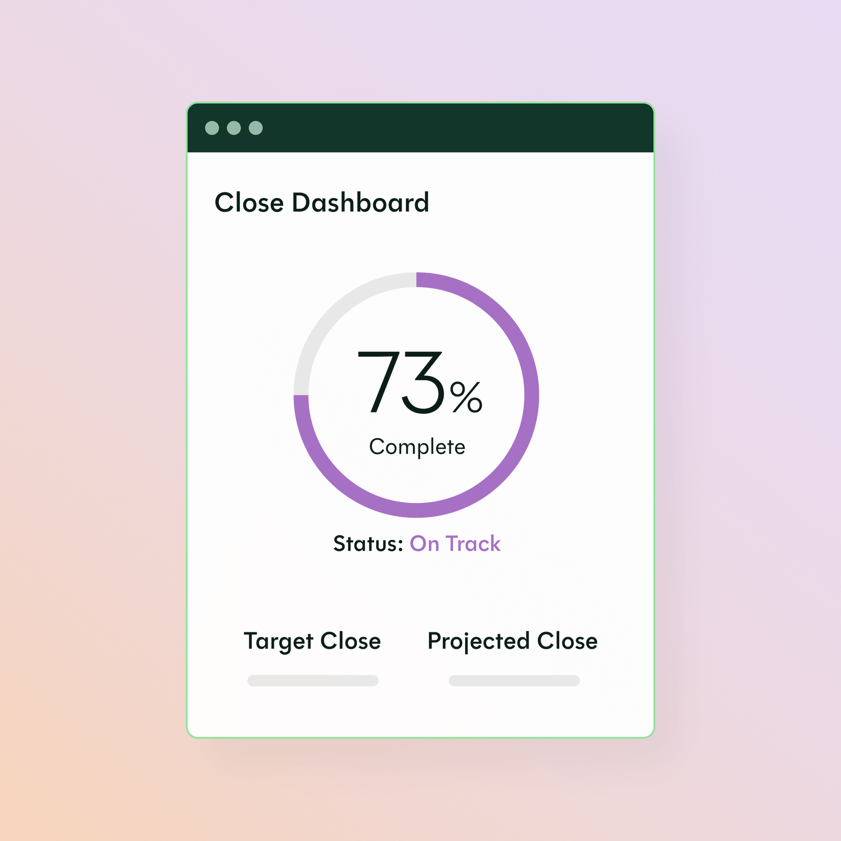
Retour d'expérience d’Owkin: FloQast Close Management
Notes:
How we can help (Agents interact across ATP):
Here is an overview of the FloQast Platform, built and designed for enterprise scale and performance. Customers can choose which part of the platform they’d like to start with – from gaining visibility into global operations to further automating account reconciliations. Many of our clients also use our Compliance module given its connectivity to the close and ability to manage your full internal control environment. Our vision for the platform is to layer on what we call AI Intelligence – with years of close and compliance data, teams will be able to ask questions and get actionable results into what matters most to them.
At the core, we have our AI Agents, capable of interacting and automating work across both close and compliance. The combination of agents working across a robust platform is what makes our AI technology unique.
The coolest part about our Agents is that you can customize them to fit your business. My favorite example is from one of our customers – a large global investment firm who does fund accounting. They weren’t sure where exactly to start with Agents. So, we turned to their existing documentation, their close checklist. We realized most of accounting work is often “death by a thousand paper cuts” meaning, we keep chipping away at it until we’re finally done. We actually saw this as an advantage because this type of work is exactly what was documented on their checklist.
Using the checklist as a roadmap to automation, we were able to hone in on their management fee allocation process, a process that was taking them days to finish. Today, an agent kicks off the task, standardizes the data, performs a variety of calculations, creates and posts the JE and validates the internal control against this process was operating effectively. This is a great example of how a customized AI Agent can help you.

Slide 10

La Vision: Optimiser aujourd'hui pour automatiser demain
Notes:
How we can help (Agents interact across ATP):
Here is an overview of the FloQast Platform, built and designed for enterprise scale and performance. Customers can choose which part of the platform they’d like to start with – from gaining visibility into global operations to further automating account reconciliations. Many of our clients also use our Compliance module given its connectivity to the close and ability to manage your full internal control environment. Our vision for the platform is to layer on what we call AI Intelligence – with years of close and compliance data, teams will be able to ask questions and get actionable results into what matters most to them.
At the core, we have our AI Agents, capable of interacting and automating work across both close and compliance. The combination of agents working across a robust platform is what makes our AI technology unique.
The coolest part about our Agents is that you can customize them to fit your business. My favorite example is from one of our customers – a large global investment firm who does fund accounting. They weren’t sure where exactly to start with Agents. So, we turned to their existing documentation, their close checklist. We realized most of accounting work is often “death by a thousand paper cuts” meaning, we keep chipping away at it until we’re finally done. We actually saw this as an advantage because this type of work is exactly what was documented on their checklist.
Using the checklist as a roadmap to automation, we were able to hone in on their management fee allocation process, a process that was taking them days to finish. Today, an agent kicks off the task, standardizes the data, performs a variety of calculations, creates and posts the JE and validates the internal control against this process was operating effectively. This is a great example of how a customized AI Agent can help you.

Slide 11

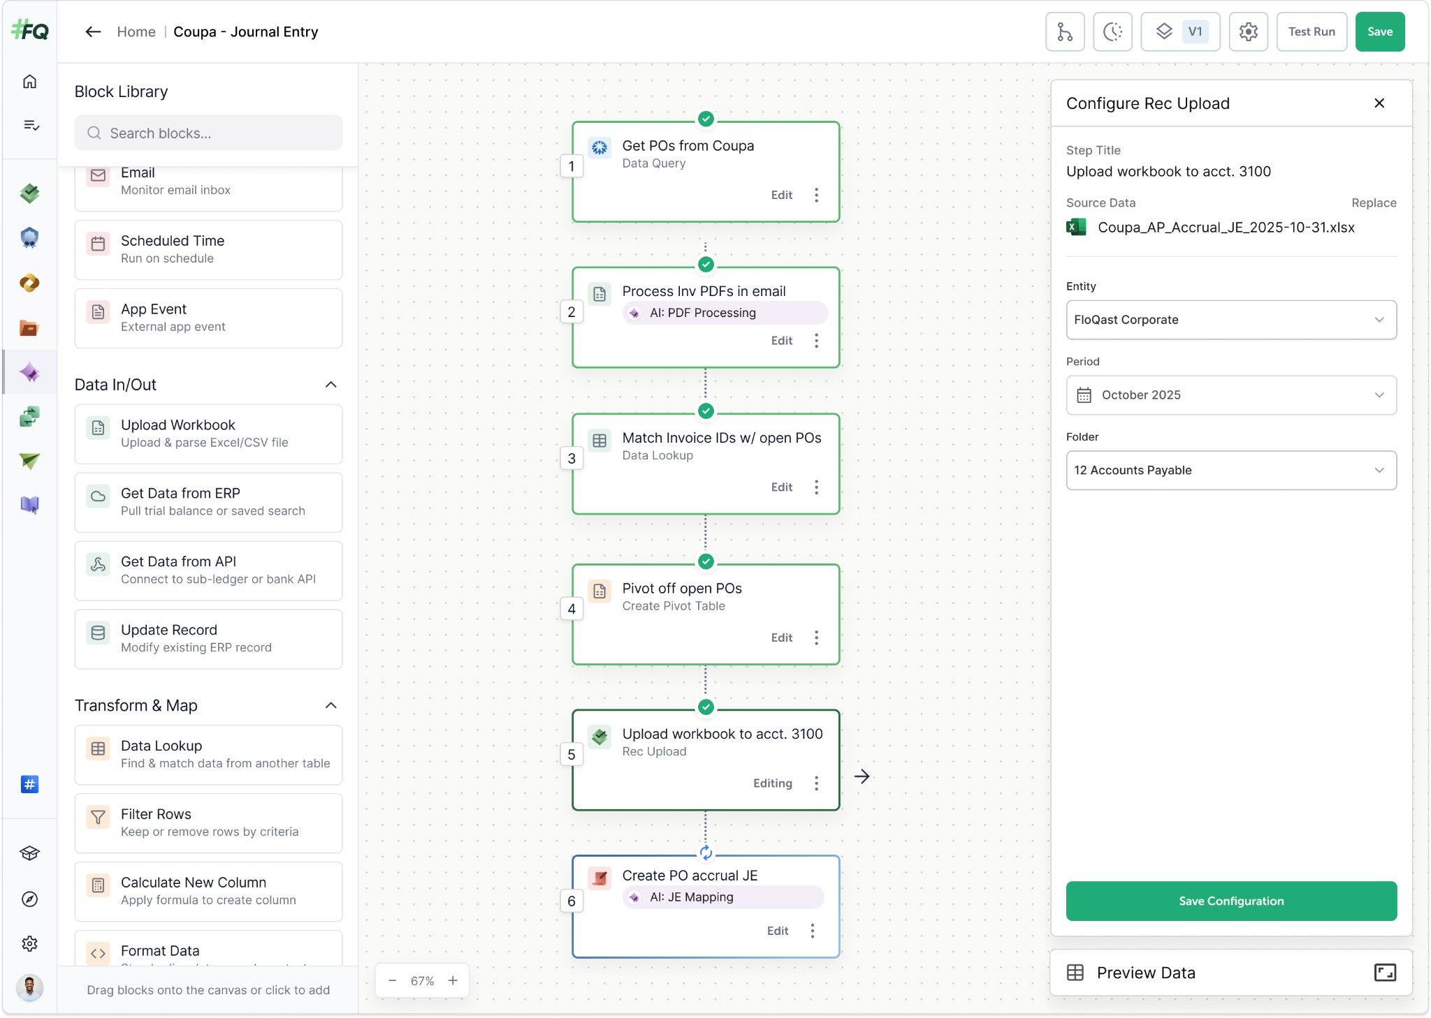
Passons de la théorie, à la pratique…
Notes:
Who helps you succeed:
We’ve also taken this a step further. In order to make sure teams were comfortable using Agents, what better way than to make it so easy that accountants can build & train agents themselves? This is exactly what the team at Tropic did over the course of a few hours – and they saw immediate value within their close.
Our Agents live in the Transform product – this is where you go to design, test and deploy Agents of your choice.
Our #1 goal is to make sure you’re successful with AI. We focus on adoption by providing you with options:
FQ Dedicated Expert: FloQast sends a Forward Deployed Accountant, an AI Agent expert, on-site for 2 weeks. They will build agents with you & certify team members.
Partners: Use our partner network, who are trained on our platform. Go big with EY for a broader transformational project or use a regional partner for an ongoing engagement
We will also assign Accounting Success Managers to ensure your team is comfortable with the FloQast platform and we’ve invested in the team of Forward Deployed Accountants to ensure AI Agents are built and adopted well.
One of the best success stories has to be from Hubspot. Their CFO did it right. He asked the team who wanted to be involved in building Agents with FloQast and approx. 20 people raised their hands. Folks who were excited about the technology. Our team of FDAs went on site and put them through training. Day 1 was learning the platform and getting up to speed. Day 2 was spent building agents together. And a wise decision by the CFO to include the team – they were involved in buying decisions, got trained up and were pivotal in getting agents deployed and adopted.

Slide 12

Questions?
Notes:
How we can help (Agents interact across ATP):
Here is an overview of the FloQast Platform, built and designed for enterprise scale and performance. Customers can choose which part of the platform they’d like to start with – from gaining visibility into global operations to further automating account reconciliations. Many of our clients also use our Compliance module given its connectivity to the close and ability to manage your full internal control environment. Our vision for the platform is to layer on what we call AI Intelligence – with years of close and compliance data, teams will be able to ask questions and get actionable results into what matters most to them.
At the core, we have our AI Agents, capable of interacting and automating work across both close and compliance. The combination of agents working across a robust platform is what makes our AI technology unique.
The coolest part about our Agents is that you can customize them to fit your business. My favorite example is from one of our customers – a large global investment firm who does fund accounting. They weren’t sure where exactly to start with Agents. So, we turned to their existing documentation, their close checklist. We realized most of accounting work is often “death by a thousand paper cuts” meaning, we keep chipping away at it until we’re finally done. We actually saw this as an advantage because this type of work is exactly what was documented on their checklist.
Using the checklist as a roadmap to automation, we were able to hone in on their management fee allocation process, a process that was taking them days to finish. Today, an agent kicks off the task, standardizes the data, performs a variety of calculations, creates and posts the JE and validates the internal control against this process was operating effectively. This is a great example of how a customized AI Agent can help you.

